Slide 1
Delivery Standardization Group 1
Maddie Lee, Alexia Wells, Leah Ekblad, Whitney Holt
Notes:
"Hello! My name is Leah and I’m joined by my teammates Maddie Lee, Alexia Wells, and Whitney Holt and today we will be presenting our delivery standardization approach”

Slide 2



Balancing Cost Efficiency with Growth Potential
Sales Volume
1
Goal: Transition low-volume customers to ARTM using white truck deliveries
1% Increase
2
Risk: Moving to ARTM prematurely could hinder revenue growth
Revenue
-5% Decrease
3
Plan: Use data driven insights to identify customers that should remain on red truck
3
Notes:
"Swire Coca-Cola is transitioning lower-volume customers to Alternate Route to Market, leveraging third-party white truck deliveries to optimize costs. While this improves efficiency, there’s a risk: some low-volume customers may have high growth potential.
Despite a 1% increase in sales volume in 2023, revenue actually declined by 5% as stated in the Swire Pacific 2023 Annual Results Highlights
Our approach is to use data-driven insights to determine which customers should remain on direct red truck delivery.
Our presentation today will share insights from descriptive, predictive, and prescriptive analytics as well as a few suggested next steps.
Now I will turn it over to Whitney to share some descriptive analytic insights

Slide 3
Descriptive Analytics:
Tableau Dashboard
Notes:
Whitney: Dashboard (3 minutes) Our group created an interactive dashboard intended to allow Swire to view and engage with descriptive analytics.
We specifically wanted to allow for real-time ‘what-if’ analysis, enabling logistics teams to determine optimal White Truck vs. Red Truck assignments.
I’d like to provide a brief overview of the dashboard, and how it could potentially be used to inform decisions:
Colors & Filters (key features - identified either by SWIRE or our predictive model)
Threshold can be changed on the fly to see how the segmentation of units ordered and total delivery cost would be impacted by a change in threshold (Total Delivery Cost vs Revenue)
In time new data could be added to this dashboard, even output from predictive models, which could potentially drive automated truck assignments, lower costs, and enhance efficiency.
Insights available on this dashboard helped shape our team’s model and segmentation strategy which Alexia will talk about next.

Slide 4
Predictive Analytics:
Regression Model

Slide 5
Modeling Approach
1
Response Variable: Total Units Ordered
Multicollinearity present in the data
3
Attempted a variety of models
3
Decided on linear regression for a balance of performance and interpretability
Notes:
The intention behind our model was to predict the volume of units ordered, using total_units_ordered as the response variable. Considering the nature of the data, we ran into multicollinearity. We were able to address it and continue with our modeling process. As a group, we tried several models, ultimately focusing on linear regression because of its ability to balance performance and interpretability.

Slide 6
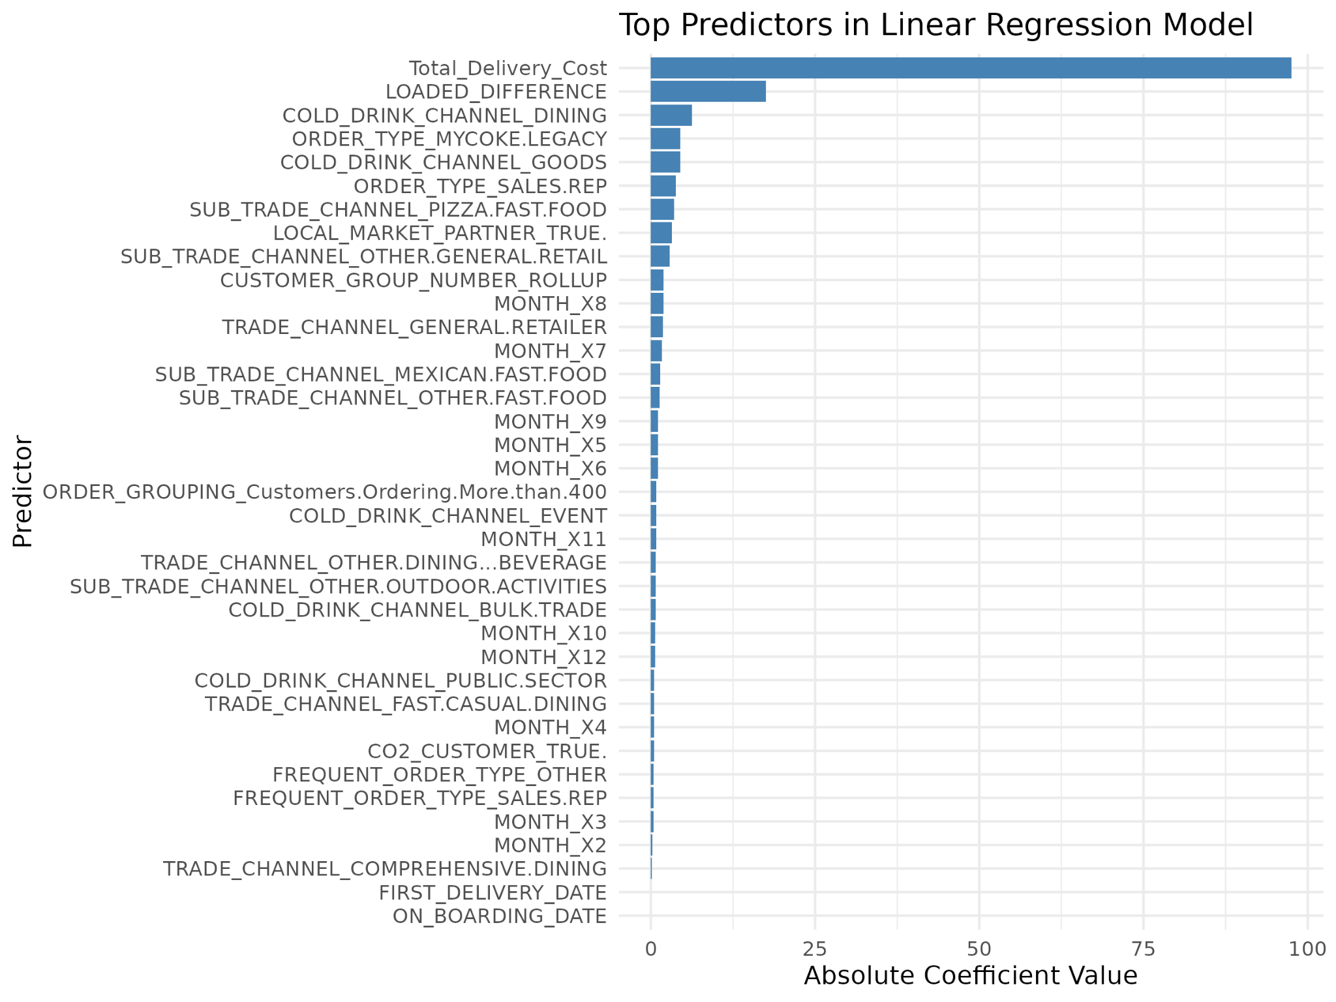
Regression Insights
Runtime
2.20 hours using full datasets on a high capacity server
Test 2023
Adjusted R-squared 0.6
R-squared 0.56
RMSE is 81.90
Test 2024
R-squared 0.57
RMSE is 92.6
Time lag present
Notes:
With that said, our model was trained on 2023 data and tested on a 2023 test set as well as the full 2024 data. The model takes about 2 hours to run and the results are promising.
The R-squared values for train and test are fairly similar, suggesting the model is generalizing well to the new data. We know that the model is not overfitting, but underfitting is possible. One way to mitigate this in the future is to add model complexity through interaction terms or attempting other supervised methods.
Moving on to the top 5 predictors:
Our first is total delivery cost, which makes intuitive sense that higher total annual costs are correlated with larger order volumes.
Next is loaded difference which is a feature engineered column that represent the amount of ordered - loaded gallons and cases.
Then we have cold drink_channel Dining - Likely indicates that customers associated with dining establishments are linked to higher order volumes.
Then we have order type mycoke. Legacy - Which was the old digital ordering platform which may suggest a long-standing customer relationship and loyalty to the company.
Finally, the Cold drink channel Goods indicates customers associated with retail or grocery environments
Moving forward, this model can serve as a baseline to be enhanced over time. Regular model monitoring and validation are crucial to ensure consistent performance as the dataset evolves. Now, we will hear from Maddie!

Slide 7
Prescriptive Analytics:
Insights
Notes:
Thanks Alexia
Building on our predictive insights, we now shift to prescriptive analytics—using customer segmentation and routing strategies to recommend targeted actions that drive both efficiency and growth.

Slide 8
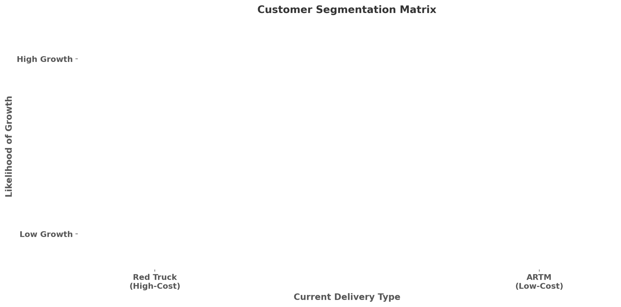
Routing Actions to Maximize Growth
High Value, Loyal
High Value, Loyal
At-Risk Misclassified
Growth Ready
Low Potential (Red Truck)
At-Risk Misclassified
Low Potential (Red Truck)
Low Potential (White Truck)
Notes:
Maddie -customer segmentation (1 minute)
“Using historical volume, delivery type, and regression analysis, we built this segmentation matrix to better understand which customers benefit from red truck versus White Truck.
In the top left, we see High Value, Loyal customers — they’re already delivering enough value to justify red truck delivery.
But where we really want to focus is the Growth Ready and At-Risk Misclassified customers. These groups are trending upward or show high modeled potential, even if they don’t meet the current threshold. Removing them from red truck too early risks losing long-term revenue.
On the other hand, customers in the lower corners — labeled Low Potential — are ideal for White Truck, but we still recommend ongoing monitoring to make sure they’re not underestimated.”
Now let’s see a customer example in our dashboard

Slide 9
Customer Example
Notes:
1min Using the dashboard swire can look at customer growth in real time. Here is a customer that showed a total volume of only 115 gallons in 2023 but that grew to 386 gallons in 2024. That’s over a 200% increase in just one year. Under the current methodology, this customer would have been identified as white truck ignoring the growth potential. Swire could use our dashboard to identify and flag high growth potential customers like this for earlier intervention.
600574417
To act on insights like this, we developed a set of routing recommendations aligned with customer growth potential and our segmentation analysis

Slide 10
Routing Actions to Maximize Growth
Recommendation | Insight Source & Next Step
✅ Retain Growth-Ready & At-Risk Misclassified on Red Truck | • Identified through segmentation matrix & regression trends • Retain red truck access to support volume lift
🔄 Refine White Truck Routing Criteria | • Tableau dashboard shows sub-400 gal/year accounts trending up • Move beyond fixed threshold — incorporate growth slope
👀 Monitor Low Potential Accounts on White Truck | • Regression & dashboard show flat/no growth • Reassess quarterly to validate classification
🚩 Flag Near-Threshold Movers | • Regression slope > 0 for borderline accounts • Add a flag to Tableau for proactive review
Insights powered by regression modeling, Tableau dashboard, and customer segmentation.
Notes:
Maddie 1-2 min
Our team recommends that Swire revisit its account classifications, as segmentation and regression analysis suggest several ‘Growth Ready’ and ‘At Risk’ accounts may be misclassified—some showing potential for growth or early signs of churn. The Red Truck model continues to provide value through consistent service and strong rep relationships, and we recommend keeping it in place for high-potential accounts. To boost digital engagement, Swire should promote MyCoke360 through light training and targeted incentives.
White Truck routing criteria should also be refined to consider account growth trends, not just volume. Several sub-400 gallon accounts are trending upward and could benefit from early support via inside sales and hybrid fulfillment. Low-growth accounts on the White Truck could shift to self-service, with ongoing engagement through quarterly surveys or campaigns.
We also recommend quarterly reviews of account classifications, flagging borderline accounts showing positive trends for monthly monitoring and potential short-term support or incentives. This approach helps Swire invest where growth is likely while scaling back service where returns are limited. With that, I’ll hand it over to Leah to walk us through next steps.
And with that, I’ll hand it over to Leah to walk us through next steps.

Slide 11
What’s Next?

Slide 12





What’s Next
Regression forecasting with additional data
Tableau Dashboard
Clustering
Black Box Machine Learning Models
Notes:
—------------------------------------------------------------------------------------------------------------------------------------------------------------
"Thanks, Maddie!
Overall, our team deployed over 20 advanced models, with Linear Regression achieving the best performance. By integrating regression forecasting, Swire could refine its 400-unit threshold for smarter routing decisions.
We also developed a Tableau Dashboard for real-time ‘what-if’ analyses, enabling teams to determine optimal White Truck vs. Red Truck assignments.
Looking ahead, clustering analysis could also help uncover deeper customer patterns, while black-box machine learning models could improve predictive power, ultimately balancing cost efficiency and growth.
Now we will open up the floor for any questions you may have "
Black-box machine learning models, like deep neural networks, support vector machines (SVMs), and random forests, are characterized by their complex, opaque decision-making processes, making it difficult to understand why a specific prediction is mad

Slide 13
THANK YOU
Questions?

Slide 14
Appendix

Slide 15
How to access the Tableau Dashboard
1 Download & Install
Tableau Reader
https://www.tableau.com/products/reader
2 Download the packaged
Tableau dashboard
Packaged Tableau Workbook
3 Open the packaged Tableau dashboard
in Tableau Reader

Slide 16
Data Cleaning
Factored categorical variables
Transformed dates
Removed columns with near zero variance

Slide 17
Feature Engineering
Total Units Ordered: Ordered Gallons + Ordered Cases
Total Units Loaded: Loaded Gallons + Loaded Cases
Total Units Delivered: Delivered Gallons + Delivered Cases
Loaded Difference: Total Units Ordered - Total Units Loaded
Shipment Difference: Total Units Loaded - Total Units Delivered

Slide 18
Multicollinearity
Without accounting for multicollinearity:
Unrealistic and inflated r-squared values
How we addressed it:
Removed aliased coefficients
Removed high variance inflation factors
Predictors with a VIF greater than 10 were removed to improve model stability.

Slide 19
Forecasting
We were unable to forecast future sales because of time constraints.
Possible Methodology:
Create a simulated dataset
Predict predictor variables to forecast the response variable
Feed dataset into the existing regression model
Notes:
To forecast future volumes, we would need to predict our predictor variables before using them to forecast the response variable. Once we have the predicted values for our predictors, we can combine them into a simulated dataset representing future conditions.
We would then feed this simulated dataset into our existing linear regression model to predict future order volumes. This approach allows us to project how customer ordering patterns might change over time, considering trends like cost changes or shifts in customer behavior

Slide 20
Data Improvements for Swire
Consider:
Customer-Level Data: More granular insights into purchasing patterns and preferences would enable better segmentation of customers by the defined threshold. This could improve marketing efforts and help forecast demand more accurately.
Order-Level Data: The data is currently aggregated by date and not Order ID. Adding additional columns such as Order IDs and timestamps to better track fulfillment trends and delivery performance.
Zip Code-Level Data: Instead of blinded full addresses and zip codes, removing full addresses and having accurate zip codes would allow for demographic comparisons while maintaining data privacy.
Notes:
Incorporating more data would help detect the intricacies behind changes in ordering volume and more.

